Slide 1




Astronomy 1020 chapter 19
Clayton State University
Slides for Astronomy textbook from OpenStax
https://openstax.org/books/astronomy/

Slide 2
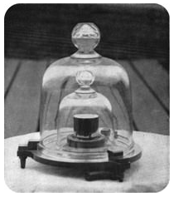

The metric system revisited
Original metric system – a set of standards
  Need to maintain
  Need to go specific place to compare with standard
Modern definitions:
  Using basic physics laws
  Any laboratory can measure
    The second is defined as being equal to the time duration of 9,192,631,770 periods of the photon frequency corresponding to the transition between the two hyperfine levels of the fundamental unperturbed ground-state of the caesium-133 atom
One meter – distance, traveled by light in 1/299,792,458 second.
One light second - 299,792,458 meters.
Leads to definition of the light year.

Slide 3
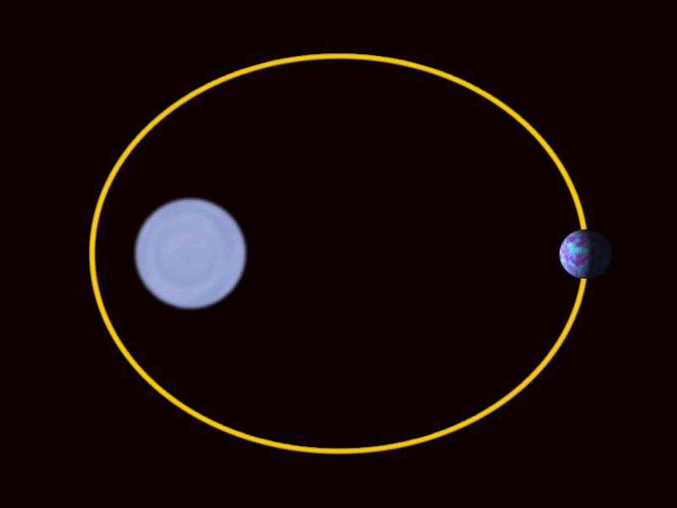
1 AU
speed of light c=3×10⁸m/s=300 000 km/s
1 light-second: ls=3×108m=300 000 km
1 AU=1.50×10¹¹m=1.50×10⁸km=500 light-seconds
When Earth and the Sun are closest, they are about 147.1 million kilometers apart;
when Earth and the Sun are farthest, they are about 152.1 million kilometers apart.
The average of these two distances is called the astronomical unit (AU).
The length of the AU is known to a precision of about one part in a billion.
1 AU:
  499.004854 light-seconds
  about 8.3 light-minutes.
  149,597,870,700 meters.

Slide 4
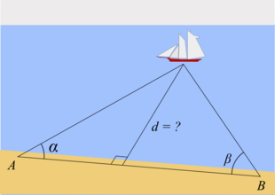
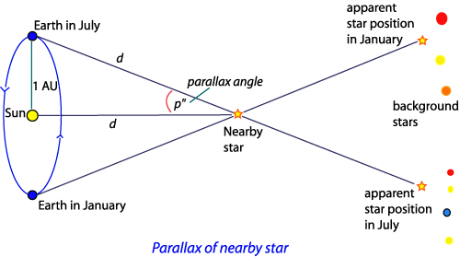
Triangulation in Space – a parsec
The apparent change in direction of the remote object due to a change in vantage point of the observer is called parallax
Parallax of 1 arcsecond = distance of 1 parsec (206,265 AU, or 3.26 light-years.)

Slide 5
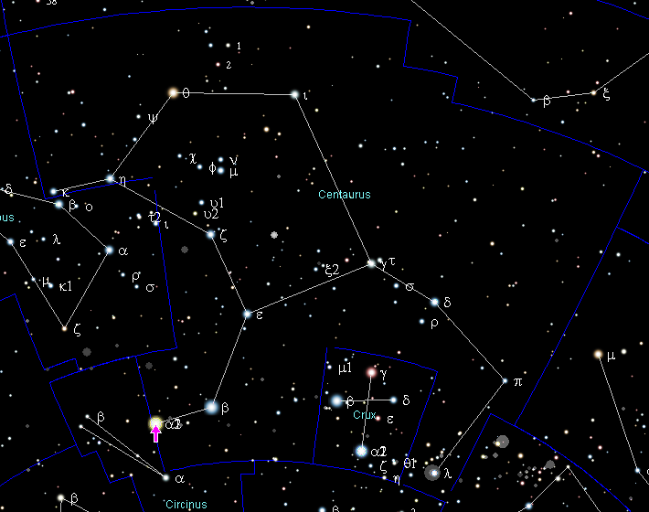
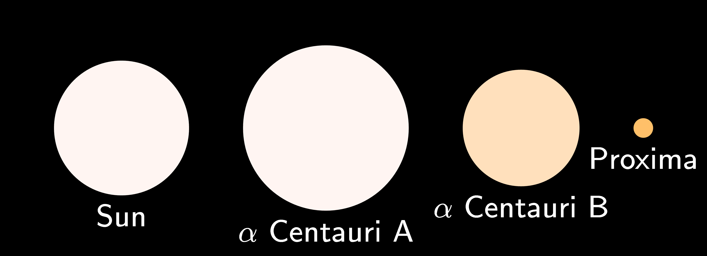
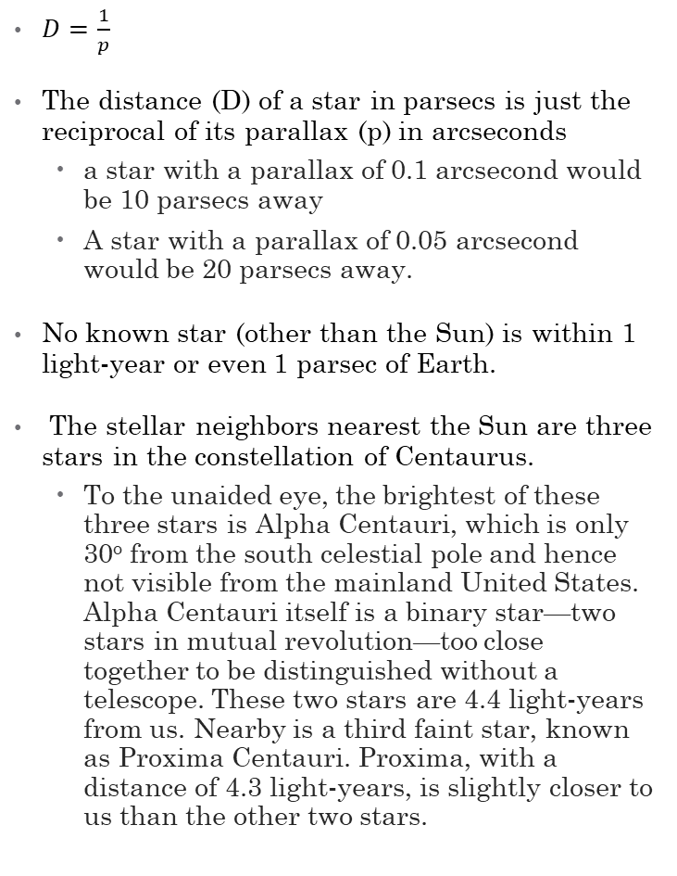
Nearest stars
$D=\frac{1}{p}$
The distance (D) of a star in parsecs is just the reciprocal of its parallax (p) in arcseconds
  a star with a parallax of 0.1 arcsecond would be 10 parsecs away
  A star with a parallax of 0.05 arcsecond would be 20 parsecs away.
No known star (other than the Sun) is within 1 light-year or even 1 parsec of Earth.
The stellar neighbors nearest the Sun are three stars in the constellation of Centaurus.
  To the unaided eye, the brightest of these three stars is Alpha Centauri, which is only 30º from the south celestial pole and hence not visible from the mainland United States. Alpha Centauri itself is a binary star—two stars in mutual revolution—too close together to be distinguished without a telescope. These two stars are 4.4 light-years from us. Nearby is a third faint star, known as Proxima Centauri. Proxima, with a distance of 4.3 light-years, is slightly closer to us than the other two stars.

Slide 6
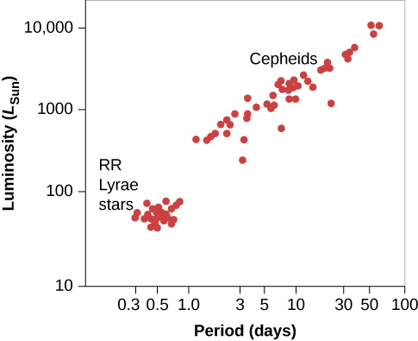
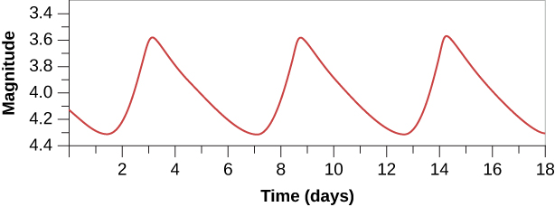
Cepheid variable stars
Cepheids are large, yellow, pulsating stars named for the first-known star of the group, Delta Cephei.
Several hundred cepheid variables are known in our Galaxy. Most cepheids have periods in the range of 3 to 50 days and luminosities that are about 1000 to 10,000 times greater than that of the Sun. Their variations in luminosity range from a few percent to a factor of 10.
Polaris, the North Star, is a cepheid variable that, for a long time, varied by one tenth of a magnitude, or by about 10% in visual luminosity, in a period of just under 4 days.
The period-luminosity relationship allows to find a distance to the variable star.
The most distant known variable stars are all cepheids, with some about 60 million light-years away.

Slide 7
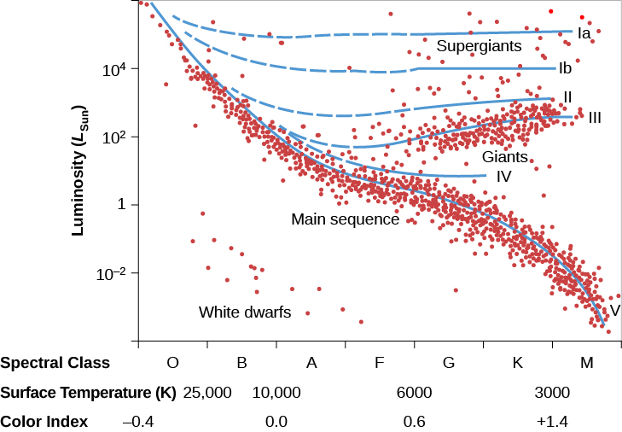
Distance using H-R diagram
If you can determine the star’s spectral class, you can get the luminosity from the H-R diagram and measure the distance this way.
Distance Range of Celestial Measurement Methods
Method | Distance Range
Trigonometric parallax | 4–30,000 light-years when the Gaia mission is complete
RR Lyrae stars | Out to 300,000 light-years
H–R diagram and spectroscopic distances | Out to 1,200,000 light-years
Cepheid stars | Out to 60,000,000 light-years

Slide 8
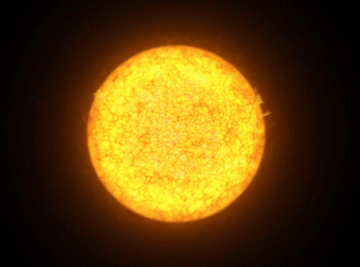
Any Questions?
Artist's impression of a Cepheid variable star. https://i.gifer.com/3WGR.gif

